Slide 1
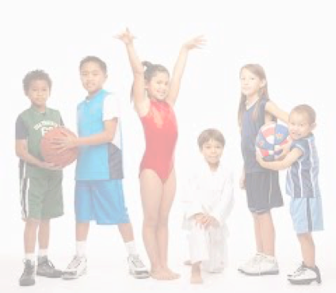
Racial Variations in Understandings and Experiences of Organized, Out-of-School Youth Activities
Douglas Hartmann, Teresa Toguchi Swartz, and
Alex Manning
University of Minnesota

Slide 2
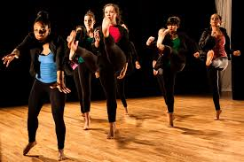
Outline of Presentation
Outline of Presentation
I. Existing Literature, Main Research Questions
II. Overview of KIDS Project and Interview Sample
III. Initial Findings
IV. Some Conclusions, Implications

Slide 3
I. Background

Slide 4
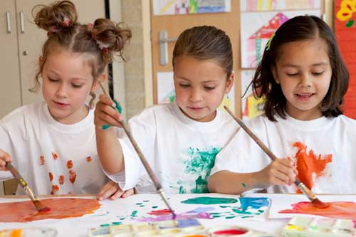
Youth, Out-of-School Activities: What We Know
1. Associated with positive outcomes (Mahoney, Larson, Eccles eds., 2005)
Social: Academic achievement; Health (physical and mental); Lower drop-out rates and delinquency rates;
Development of soft-skills like self-esteem resilience, leadership, teamwork (human capital)
2. Hidden aspect of growing class inequalities (Putnam 2015)
“Pay-to-play” format and privatization of programs has increased since 1980s;
Children in low-income families less likely to participate
Extra-curriculars as key dimension of growing class inequalities (Putnam, 2015)

Slide 5
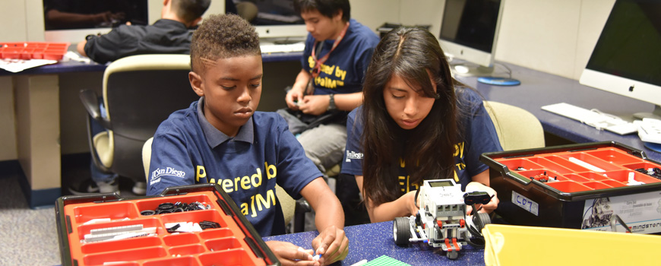
What We Don’t Know: Research Questions
How are variations linked to social reproduction?
Intensity of involvement
Levels of competition
Individual or group orientation
Organizational context, funding, cost, and other dimensions
How do families navigate the selection process?
How do different families make sense of various benefits and challenges?
How do class and race intersect to shape these choices and experiences?
1. What does this youth activity system as a whole currently look like?
2. How do parents and kids (and others) perceive the various benefits and challenges of youth activities, and see the system as a whole?
3. How is all this implemented and experienced on-the-ground, on an everyday basis?
Some theories on class inequalities (Lareau’s Unequal Childhoods); very little on race/race differences
How are variations linked to social reproduction?
Intensity of involvement
Levels of competition
Individual or group orientation
Organizational context, funding, cost, and other dimensions
How do families navigate the selection process?
How do different families make sense of various benefits and challenges?
How do class and race intersect to shape these choices and experiences?

Slide 6
II. Kids Involvement and Diversity Study (KIDS Project)

Slide 7
KIDS—Main Research Elements
Some “historical” work
Demographics and mapping
Targeted case studies—collaborative, institutional ethnography
Interviews

Slide 8
Interview Sample
65 parents
45 mothers
20 fathers
35 White, 30 Parents of Color
About half above the MN median family income, and half below
75 youth 10-18
Half White
Half Black, Asian American, Latin@, Native American

Slide 9
Twin Cities as Research Site/Case Study
Historic commitment to education
Parks facilities and community infrastructure
Increasing racial, ethnic, economic diversity

Slide 10
III. Initial Findings

Slide 11
Theme 1: General Race Talk
Respondents uncomfortable talking about race—especially white parents
Prefer the language of “diversity”
”Happy Talk” (Bell and Hartmann 2007)
Diversity discourse varies by race

Slide 12
1a. Exposure v. Acceptance—white version
“I think that's important… it's really easy, particularly in our neighborhood, to see only people of certain type. [Through activities kids get] to know, to be comfortable with [diversity], and to know that we all make the world. And you get exposure to different language, different culture, different ways of thinking about things, and that your way isn't the only way.” (Patricia, White, middle class, urban)
“I don't think that you need to worry so much about diversity in school, if they're getting diversity outside of school. ‘Cause we live in the city, so you know, there's going to be diversity everywhere. Um, but that is something that they're getting through their extracurriculars, if they're doing that through the city, and so you don't need to be so concerned with it at school.” (Carrie, White, middle-class, urban)
“I definitely want them to be exposed to different kids of different nationalities, different...I like the idea of them being exposed to lots of different people, different people from different backgrounds.” (Kimberly, White, middle class, urban)

Slide 13
1a. Exposure vs Acceptance—Parents of Color
“And what I like from ...this team, it's a mix… They are Mexican-American, African-American, Jamaican people. So it's good. Also it's important because everybody can have different racial roots or different points of views, but it's okay! It's okay being Mexican-American….That's what I want him to learn.” (Maria, Mexican-American, low-income, urban)
R: For my kids to have different cultures, to embrace different cultures in [church] services and youth group….It's the diversity. I feel welcome there. I just feel like home to me. It's where you can go feel that love. It feel not just going to church I am going to my family, like second home. Those are key things for me, diversity to go where I feel at home.
I: Is important for you and your kids too? R: Yes very important. And to be comfortable. (Ron, African-American, low-income, suburban)

Slide 14
Navigating White Spaces: Avoiding Isolation
“Like with hockey for example. Hockey is traditionally a very white sport. And so, it's something that I'm always thinking... I mean race is…always on my mind, and it's always on my mind when my kids enter sport, and the way also some of the children are looked at in the sport by the other parents and by the other kids, and so I definitely think it's a factor…But, it was important that I don't just show up, here we are to play hockey. But that she already had some friends that she had made that would accept her into the group. And that was really really important to me. I was not willing to just show up and say ‘Here I want my daughter to play hockey;. Which was one of the reasons that when I arrived and when you saw me, I said, ‘Ruth go find your friend Tracy.’ (Roger, African-American, middle-class, urban)

Slide 15
1b. More explicitly racialized respondents…
Well-aware of racial differences and hierarchies, and even engage in overt racial stereotyping;
Explicit about racism in schools/education, workplace, and with respect to police;
Tend NOT to see kids activities in racial terms, want activities to be colorblind arena.

Slide 16
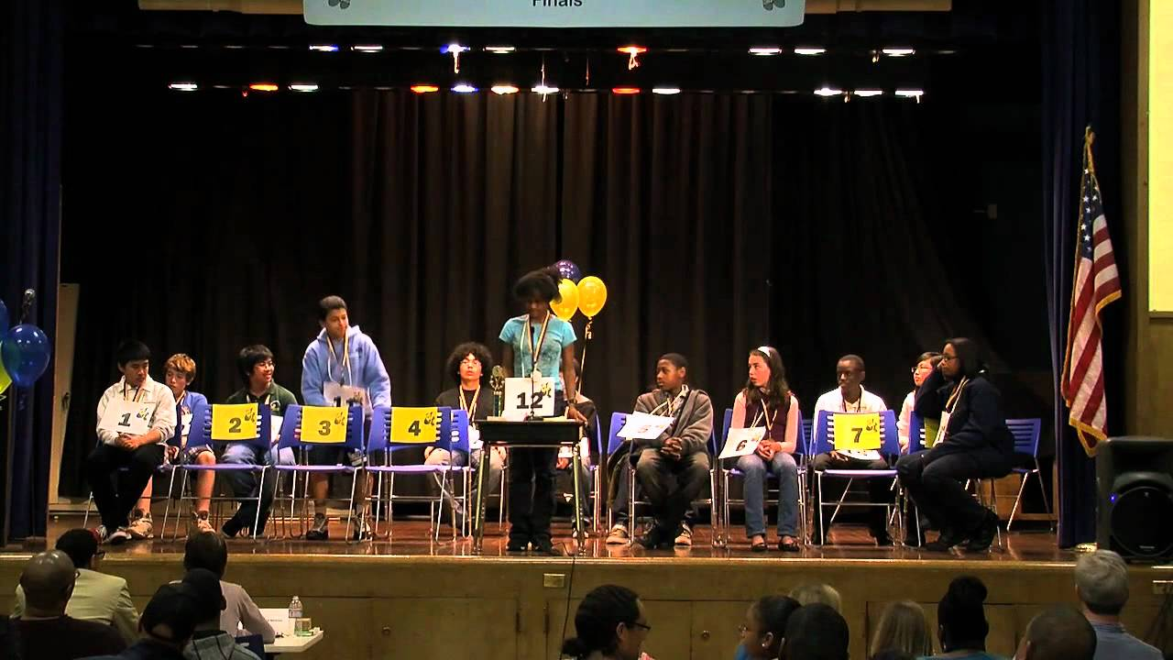
Theme 2: Motivations, Goals, and Beliefs about Youth Activities
1. Activity ethic and busyness as key institutional domain, outlet, extension of “concerted cultivation”
--confidence, resilience, self-esteem, skills-building, work ethic, teamwork, persistence, goal orientation, academic achievement, health (physical and mental), interact with others, risk avoidance
2. Believe kids should choose freely
3. Want a balance between roundedness and excellence

Slide 17
Concerted Cultivation: Activities for Future
[Activities] teach a lot of different things, work ethic, stick-to-it-iveness, teamwork. You know, other things, confidence....So it can push people out of their comfort zone. Which is really great. (Bill, White, working-class, urban)
“I think it is important to try a lot of things, but it’s important to love something and see yourself progress, and to look back at the other classes and say “Wow, I remember when I was doing that. Now, look at how far I’ve come.” (Nancy, white middle-class mother)
No matter what activity they choose… They can get a feel of what they don't like and what they do like. Later on, they can do that. Start them off young, they can do that in high school. It would just keep them busy (Lower income Black mom, urban)
“Definitely cost [$10,000/yr] has been an issue, but she loves it and this was what she wanted to do. We're still hoping that college could pay off by some scholarship money or something like that.” (Karen, Asian American, middle-class, suburban)
“That’s why I want to keep his skills up, to keep the opportunity open.” (Lara, White, lower middle-class, urban)

Slide 18
…holds across Race & Class Lines

Slide 19
Where Variations Emerge…
--Access, opportunity
--Ethno-racial socialization

Slide 20
Preparing Kids for Racism
There’s a lot of prejudice out there in the world...a lot of racist jokes. Chinese dance and adoptee groups have given them friends with the same experiences...They call themselves the rice eaters... I think that it's given my daughter, particularly my older daughter, a very positive self-image. (Jane, White, middle-class, suburban)
“... And I also think self-defense is important. I think it's empowering, for all the bullying and things like that that go on in school.…Studies will show you that kids who are trained in martial arts are less likely to fight and more likely to back away from a fight, because they have the confidence, knowing that they can defend themselves. They don't have to prove anything.” (Dan, African American, middle-class, suburban)

Slide 21
Choosing for Ethnic Culture, Identity, Community
“ Marshall Men catered to African American young boys … to boost their confidence and also know about their heritage and things like that…to help these kids learn about their heritage and the things their ancestors had to go through because that’s not being taught very much in the educational system which I think is very important here in the inner city.”
(mixed race—Mexican and African American—Monica, mom, urban)

Slide 22
Risk Avoidance Through Activity Involvement
White Parents
Parents of Color
Idleness, inactivity, and unproductive time
Reducing risk
Drugs and drinking
“I guess I’m worried about drugs and alcohol, specifically…. Idleness leads itself to drugs or alcohol use.”
Off street to avoid victimization (younger kids)
Idleness, inactivity, and unproductive time
Reducing risk that could have potentially severe consequences
Drugs and drinking
Youth crime
Off street to avoid victimization (others, police, boys)
“I do worry about Mike being Black going out in public without protection. .. That’s going to be a learning process our whole life.”

Slide 23
Theme 3: Uneven Access and Differential Treatment
Increase of private, non-school-based activities difficult to access for families with less material, cultural, social resources
Families of color and immigrant families often rely on schools for access to activities
Parents of color feel isolated in majority-white, middle-class activities
Differential, racialized treatment

Slide 24
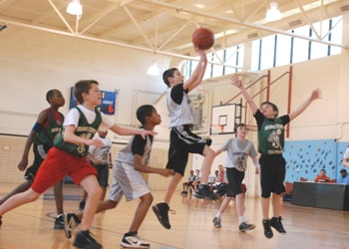
3a. Uneven Access: Money and Cultural Knowledge
“I really have to look for things for them. And sometimes it took me a long time because of the schedule, and the places, if they're too far away. The times, and the money, how much I have to pay. If they offer scholarships or not. I have to see all of those things.” (Maria, Mexican-American, Urban)
“I found out he would have to pay like $175, and I was like we don't have that. Maybe we could buy you some sneakers. And he raised the money for it. And then so I had talked with the lady over there and she was telling me if he had reduced or free lunch, then it's only $40. And I told her, well when we tried to sign up I thought it was $175, I said if I would have known it was $40 I would have then gotten him signed up. It's just that part of they don't give you the right information.” (Ron, African-American, low-income, suburban)

Slide 25
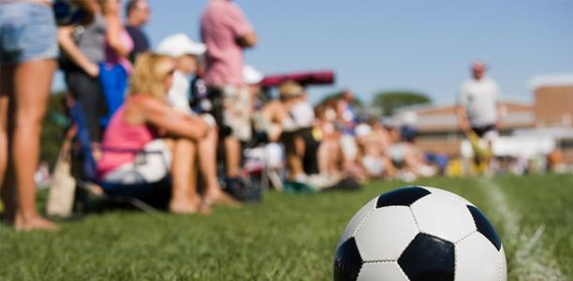
3b. Feelings of Isolation
“And it was really awkward for me, because I was a young mom and I just felt out of...I couldn't relate to the other moms. I wasn't white. I wasn't middle age. I wasn't financially stable... And so I just felt really uncomfortable. Because when they're little, you waiting there. And they just seem to know what they’re doing. …And so, yeah. It was uncomfortable for me.” (Olivia, Latina, working-class, urban)

Slide 26
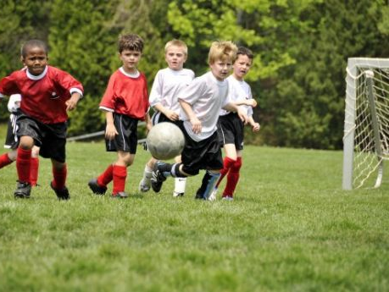
3c. Differential Treatment
“And they were practicing and Mike won the ball from Jack, tackled him…and as he was leaving, Jack said “something, something chocolate boy.” And Mike interpreted it immediately as a racial comment and he came home and talked to me about it. He said “Mom, Jack called me chocolate boy.” And I said “mmmm, how did that feel?” And he’s like “I think he was being racist.”
So, I went directly to Dan, the head of the organization and Dan said “No room for that, not okay.” I talked to Forrest the coach, and when I talked to Forrest I had a similar experience as when I talk to white families about Mike being treated differently by refs. They don’t identify.
(Lara, White, middle-class, adopted African-American son, urban)

Slide 27
3d. Experiences with Blatant Racism
“And they’re calling our girls {High School X} monkeys. Where they’re chanting Monkey’s...I feel like some of these white schools come into our inner-city schools, and have this elitist-ass attitude and feel like they can treat and talk to our kids any type of way…because we have less money or we appear to have less money or because we’re of color.”

Slide 28
3e. White Parents and Racism
Variation 1: Diversity ideals versus Neighborhood participation
“Unfortunately, we are at the rich kid campus. Our tennis court is right here…I said I almost feel like I should switch locations because I think this would be an advantage for him to get to know kids from another part of town but then I would have to drive him over….No, he’s not getting that much diversity.” (Kathy, white, middle class, urban)
Variation 2: Don’t know how to address racism, deal with racial issues and incidents
“…[son and teammates] call each other racist names, but like in what they think is a fun way, it’s okay, I don’t like that at all… I never used that word in my whole life and I don’t care if they tell you to say it or they like the way you say it, it kind of just makes me upset…. I don’t know. What can I do?“ (Sonya, white middle class suburban)

Slide 29
IV. Discussion, Broader Implications

Slide 30
Summary / implications
Common/shared valuation of youth activities
Unequal/uneven ability to realize these ideals—uneven access
Racialized realities: demographics, racialized culture, divergent goals in a racialized context
Mechanisms of social reproduction
Legitimation of broader ideologies of merit, access and choice, colorblindness or cosmopolitan canopy

Slide 31
Thank You!

Slide 32
Questions?
Thank you!
Questions?

